Slide 1
Cancer Biology Biol 445
Spring 2020
Dr. Heidi Super
Lecture 26
4-8-2020

Slide 2
Announcements
Quiz 4---will start grading today. You should be able to see grades and comments on BB as I submit them.
No “class” Friday or Monday---regular holiday days off on MSU schedule. Rest, catch up, and communicate any concerns.
We can meet anytime by BB collaborate---even over the holiday weekend.

Slide 3
Where were we?
UV—a potent carcinogen. Melanin-—natural UV protection.
UV---needed for Vitamin D production. Vitamin D deficiency linked to some heath problems.
*Mixed research results in some studies.

Slide 4
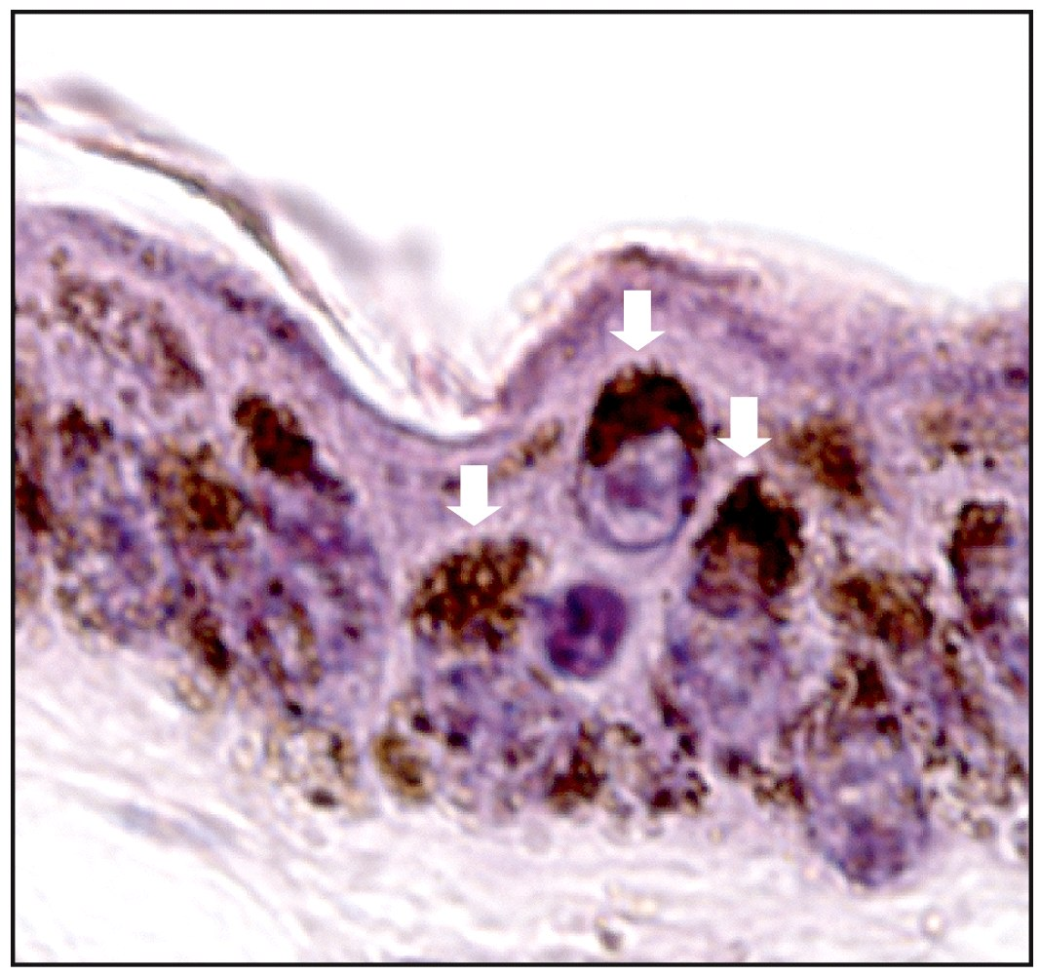
Figure 12.20 The Biology of Cancer (© Garland Science 2007)
Notes:
4

Slide 5
General exposure recommendation
10-30 minutes of sun, without sunblock, 3X a week for Caucasians. Difficult in winter months in some areas!
Vitamin D supplements/Pills. Vitamin D is not water soluble, so monitor dosage carefully.
http://www.cancer.gov/cancertopics/factsheet/prevention/vitamin-D

Slide 6
Ionizing radiation
Higher energy than UV. Penetrates into body
Strips electrons from biomolecules (makes ions)
Creates mutagens—interact with and alter DNA

Slide 7
X-rays
Discovered accidently by Wilhelm Roentgen
The image of bone is the result of absorption of X-rays by dense tissue. The image is like a shadow caused by blocking the X-ray path.

Slide 8
Absorption of energy, can result in damage to living tissue.
Acute damage---necrosis/burns/cell death
Damage to biomolecules, such as DNA.---long term effects

Slide 9
Link to cancer
First recognized high rates of cancer in X-ray workers (early radiologists)
Burns in exposed skin—necrosis.
High rates of cancer in most exposed areas and in stem cells (leukemia)
Important technology, but must be weighed against risk to DNA damage.
Medical imaging has improved to reduce exposure and decrease energy required.

Slide 10
Mechanism of damage
X-rays strip electrons from water molecules
Create free radicals which generate reactive oxygen species (ROS)
ROS damage DNA by altering bases and by inducing single and double-strand breaks
May be repaired incorrectly
May initiate DNA rearrangement (chromosome translocation)
FIGURE 6-11 textbook

Slide 11
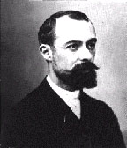
Radioactive elements
Some elements have unstable nuclei—emit energy when they lose different types of particles. (Studied uranium)
Discovered by Henri Becquerel at nearly the same time as X-ray discovery.
Late 1890s

Slide 12
Becquerel was working with a uranium compound. Shared a Nobel prize with the Curies (Marie, Pierre, and daughter, Irene) who discovered polonium and radium
Now one accepted international measurement of radioactive decay=Bq

Slide 13
Types of nuclear radiation/decay/particles
Alpha (α) particle—positively charged--Atom loses 2 protons + 2 neutrons (helium nucleus)
Beta (β) particle—negatively charged—Atom loses electron
Gamma (γ) ray—neutral , high energy photon

Slide 14
In biology, we are mainly concerned with radioactivity’s ability to damage tissues
Radioactivity is measured in several ways.
Elctron volt (eV) =overall energy
Bq (becquerel)= rate of decay
Gray (Gy)= energy absorbance (in biological tissues)
Relative biological effectiveness (RBE)=correction factor for Gy based on experimental exposures.
Gy x RBE= sievert (Sv)
X-rays, β and γ−−about equal in RBE
α−−highest RBE—about 20X more damaging.
Show films….

Slide 15
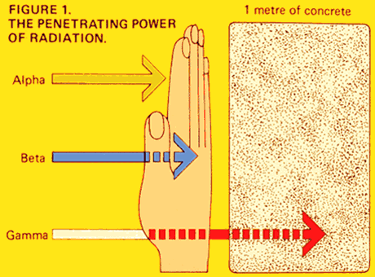
Penetrating capability is related to ability to cause DNA damage

Slide 16
The risk associated with exposure to radioactive elements is a function of both energy of the particle and its ability to penetrate human tissues.

Slide 17
“Accidental” exposures
β/γ particles
Atomic bomb survivors in Japan post WWII
Atomic bomb testing in southwestern US.
Chernobyl (Ukrane) reactor accident https://en.wikipedia.org/wiki/Chernobyl_disaster
Japan earthquake/ tsunami https://en.wikipedia.org/wiki/Fukushima_Daiichi_nuclear_disaster

Slide 18
Leukemia often seen as the predominant cancer—after radiation exposure.
Why?
Leukemia originates in a blood precursor cell present in the bone marrow. Bone marrow is one of the most active tissues in terms of cell division.
In a sense, no need for external tumor promoter once one or more DNA mutations occur. Rapid cell division is normal here, meaning DNA is replicated frequently and mutations are more likely to accumulate.

Slide 19
Leukemia increase is often overestimated
Why?
Its overall incidence is lower than most other types of cancer, so any increase is easier to spot.
The waiting period/latent period, between exposure to radiation and cancer is much shorter for leukemias than for other cancer types. The are usually the first type of cancer to show up.

Slide 20
Changing direction….Confusing concepts
We have recently reviewed some of the causes of cancer and spent a great deal of time on chemical carcinogens and radiation as causes.
Chapter 11 takes on aspects of cancer screening and treatment and points out that some of the most potent mutagens/carcinogens (including radiation) are also common treatments for cancer.

Slide 21
And many of the cancer screening method use some radiation for imaging tissue inside the body….

Slide 22
What does cancer look/feel like?
In a sense, cancer is a chronic disease (long lasting), with few early, consistent symptoms.
For most cancers, you will have carried around the abnormal mass of cells for a long time without any ill effects.

Slide 23
American Cancer Society’s list
Lump/thickening of tissue
Unusual bleeding
Unexplained weight loss
Long lasting cough or voice change
Sores that don’t heal
Changes in digestion, bladder, bowel habits
Change in mole/skin

Slide 24
None of the symptoms are…
1. Absolutely specific for cancer
2. Early signs of cancer
There is a clear advantage for the earliest detection. Figure 11-1

Slide 25
Cancer screening.
Several tests recommended to detect cancer, before physical symptoms arise.
Goal= Earliest possible detection.

Slide 26
Pap smear/test
--most successful screening test, thus far.
Looks directly at cells from tissue
Procedure to scrape a few cells from the uterine cervix to examine microscopically.
Idea/procedure developed by George Papanicolaou

Slide 27
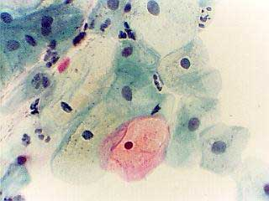
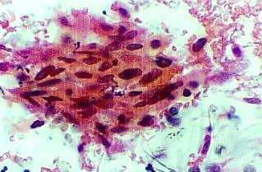
Normal
Abormal

Slide 28
General guidelines
Start pap test within 3 years of becoming sexually active or no later than 21 years of age
Why—cancer is a disease of the aged, right?
Which cancers are the exception?
Pap test every 3 years unless:
You wish to test more often (1-2 year)
You have had an abnormal pap test in the past
Since the test poses NO exposure to radiation and very very low risk of any harm, there are no contraindications for testing, other than expense.

Slide 29
Co-testing for HPV after 30 to identify whether cancer-associated strains are present. (If not, less frequent pap tests needed)
Pap tests with any sign of abnormal cells are usually followed by a more invasive biopsy.
Careful pathology analysis.

Slide 30
Abnormal pap test/NCI
Dysplasia is a term used to describe abnormal cells. Dysplasia is not cancer, although it may develop into very early cancer of the cervix. The cells look abnormal under the microscope, but they do not invade nearby healthy tissue. There are four degrees of dysplasia, classified as mild, moderate, severe, or carcinoma in situ, depending on how abnormal the cells appear under the microscope. Carcinoma in situ means that abnormal cells are present only in the layer of cells on the surface of the cervix. However, these abnormal cells may become cancer and spread into nearby healthy tissue.
Squamous intraepithelial lesion (SIL) is another term that is used to describe abnormal changes in the cells on the surface of the cervix. The word squamous describes thin, flat cells that form the outer surface of the cervix. The word lesion refers to abnormal tissue. An intraepithelial lesion means that the abnormal cells are present only in the layer of cells on the surface of the cervix. A doctor may describe SIL as being low-grade (early changes in the size, shape, and number of cells) or high-grade (precancerous cells that look very different from normal cells).
Cervical intraepithelial neoplasia (CIN) is another term that is sometimes used to describe abnormal tissue findings. Neoplasia means an abnormal growth of cells. Intraepithelial refers to the layer of cells that form the surface of the cervix. The term CIN, along with a number (1 to 3), describes how much of the thickness of the lining of the cervix contains abnormal cells.
Atypical squamous cells are findings that are unclear, and not a definite abnormality.

Slide 31
Imaging internal tissues
X-ray
CT
Ultrasound
MRI

Slide 32
Mammography
Low-dose X-ray to image breast tissue.
Can detect tumors too small to feel
Breast tissue varies tremendously in density so the procedure has a fair number of false positive and false negative outcomes.
Baseline image is always compared year to year.

Slide 33
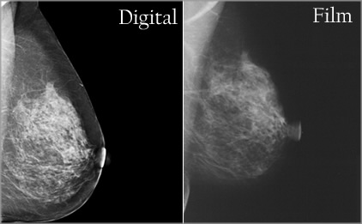
Recent advances in technology---digital image
Still require X-rays

Slide 34
Newest technology—3D mammography

Slide 35
Shift in practice…
Summaries of long term studies of mammograms and breast cancer were made public in 2014.
Surprisingly, mammograms were shown to be less effective in preventing death from breast cancer than predicted
Unsettling to the general public, but new guidelines were introduced, based on the science.

Slide 36
Guidelines as of October 2015
For women at average risk
Women ages 40 to 44 should have the choice to start annual breast cancer screening with mammograms if they wish to do so. The risks of screening as well as the potential benefits should be considered.
Women age 45 to 54 should get mammograms every year.
Women age 55 and older should switch to mammograms every 2 years, or have the choice to continue yearly screening.
Screening should continue as long as a woman is in good health and is expected to live 10 more years or longer.
All women should be familiar with the known benefits, limitations, and potential harms associated with breast cancer screening. They should also be familiar with how their breasts normally look and feel and report any changes to a health care provider right away.

Slide 37
For women at higher than average risk
Women who are at high risk for breast cancer based on certain factors should get an MRI and a mammogram every year. This includes women who:
Have a lifetime risk of breast cancer of about 20% to 25% or greater, according to risk assessment tools that are based mainly on family history (such as the Claus model – see below)
Have a known BRCA1 or BRCA2 gene mutation
Have a first-degree relative (parent, brother, sister, or child) with a BRCA1 or BRCA2 gene mutation, and have not had genetic testing themselves
Had radiation therapy to the chest when they were between the ages of 10 and 30 years
Have Li-Fraumeni syndrome, Cowden syndrome, or Bannayan-Riley-Ruvalcaba syndrome, or have first-degree relatives with one of these syndromes

Slide 38
Changes…
Clinical breast exam and breast self-exam
Research does not show a clear benefit of physical breast exams done by either a health professional or by yourself for breast cancer screening. Due to this lack of evidence, regular clinical breast exam and breast self-exam are not recommended. Still, all women should be familiar with how their breasts normally look and feel and report any changes to a health care provider right away.

Slide 39
New paper linked to website…2 physician authors provide guidelines for 2018.

Slide 40
Colon cancer screening
Until recently, colonoscopy was the most common way to detect colon cancer.

Slide 41
Former colon cancer screening guidelines
Screening should start at 50.
Colonoscopy every 10 years
For people ages 76 through 85, the decision to be screened should be based on a person’s preferences, life expectancy, overall health, and prior screening history.
People over 85 should no longer get colorectal cancer screening.
High risk individuals (with first degree relatives having had colon cancer) start earlier, test more often and/or use a combination of tests (see next slide)
One benefit of colonoscopy is that biopsy can occur simultaneously if abnormality is detected (polyp removed for examination)
Removing polyps can stop cancer progression.

Slide 42
2 other screening tests are available and routinely done
Sigmoidoscopy (smaller scope, views only part of the colon)
Fecal examination (fecal occult blood test—FBOT)
Identifies blood in feces---an abnormal condition that may indicate colon cancer—can be done often, even at home.
i.e.
Gene testing on cells found in feces—Looking for APC mutations!

Slide 43
More recent guidelines
Screening should start at 45, but can include the stool test looking for blood. High incidence of blood in stool and colon carcinoma.

Slide 44
Tests that find polyps and cancer
Flexible sigmoidoscopy every 5 years*
Colonoscopy every 10 years
Double-contrast barium enema every 5 years*
CT colonography (virtual colonoscopy) every 5 years*
Tests that mainly find cancer
Guaiac-based fecal occult blood test (gFOBT) every year*,**
Fecal immunochemical test (FIT) every year*,**
Stool DNA test (sDNA) every 3 years*
*Colonoscopy should be done if test results are positive.
** Highly-sensitive versions of these tests should be used with the take-home multiple sample method. An FOBT or FIT done during a digital rectal exam in the doctor's office is not adequate for screening.

Slide 45
Katie Couric---a champion for colon cancer research

Slide 46
After the death of her husband, Jay Monahan, Couric made the nation more aware of the disease and its prevention. She agreed to have her colonoscopy televised!
http://www.youtube.com/watch?v=15JsYSZIT-Q
Later---Homer Simpson agreed too!
http://www.youtube.com/watch?v=6uPu1dRRfTY

Slide 47
Both videos are were produced for organization led by Couric and many celebrities---Stand Up To Cancer
http://www.standup2cancer.org/

